Slide 1

Requisites for a Cognitive Architecture
Jose C. Principe
Computational NeuroEngineering Laboratory
Electrical and Computer Engineering Department
University of Florida
www.cnel.ufl.edu
principe@cnel.ufl.edu

Slide 2
Outline
Human Inspired Sensory Processing
How Technologists Approach memory and perception
Setting the Learning problem
Learning Spatial Features
Learning Temporal Features
Generative Models

Slide 3
Functions of Human Cognition
Cognition is difficult to define: “The mental process by which knowledge is acquired, including perception, intuition, and reasoning”.
Cognition is known to exist in biological organisms, so it is perhaps more efficient to identify the cognitive system’s functions. There are four fundamental functions in cognition
Attention
Memory
Perception action cycle
Intelligence
In order to create cognitive engineering systems, they have to be understood and translated into architectures and algorithms.

Slide 4
Perception-Action-Reward-Cycle (PARC)
Human knowledge comes from three main sources:
The genetic code
The interaction with the environment
The repository of knowledge in society
The principles used by biology to extract information from the environment are only vaguely known, but involve:
Sensory stimulation
Adaptation and Learning
Stored representations
Information processing
Sensory processing is the best known and it is exquisite: (eye of the fly is sensitive to a single photon, olfaction in dogs finds one 1pp trillion, the eardrum senses 2x10⁻¹⁰ atm).

Slide 5

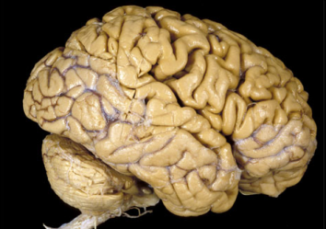
BRAIN-BODY and Physical Constraints
PAST
FUTURE
Causality line
DOES ACTION
MEET
FUTURE REALITY?
EXTERNAL
WORLD
SENSORY
STIMULUS
Body line
ORGANIZED PAST
EXPERIENCE
INTERNAL
REPRESENTATION
PREDICTIVE
MODELING
Brain is a real time system that does predictions
Past experience is stored in memory and is accessible on demand

Slide 6
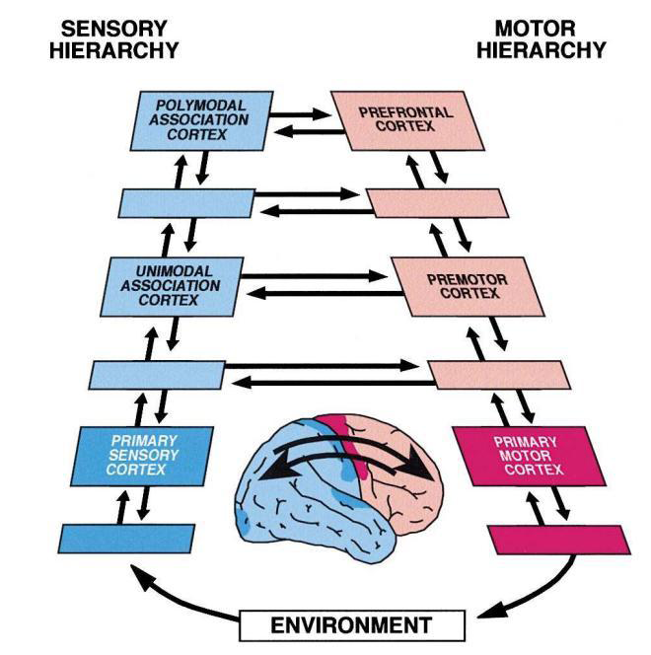
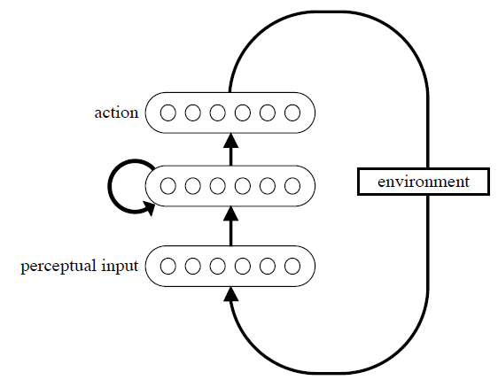
Fuster’s Hierarchy

Slide 7
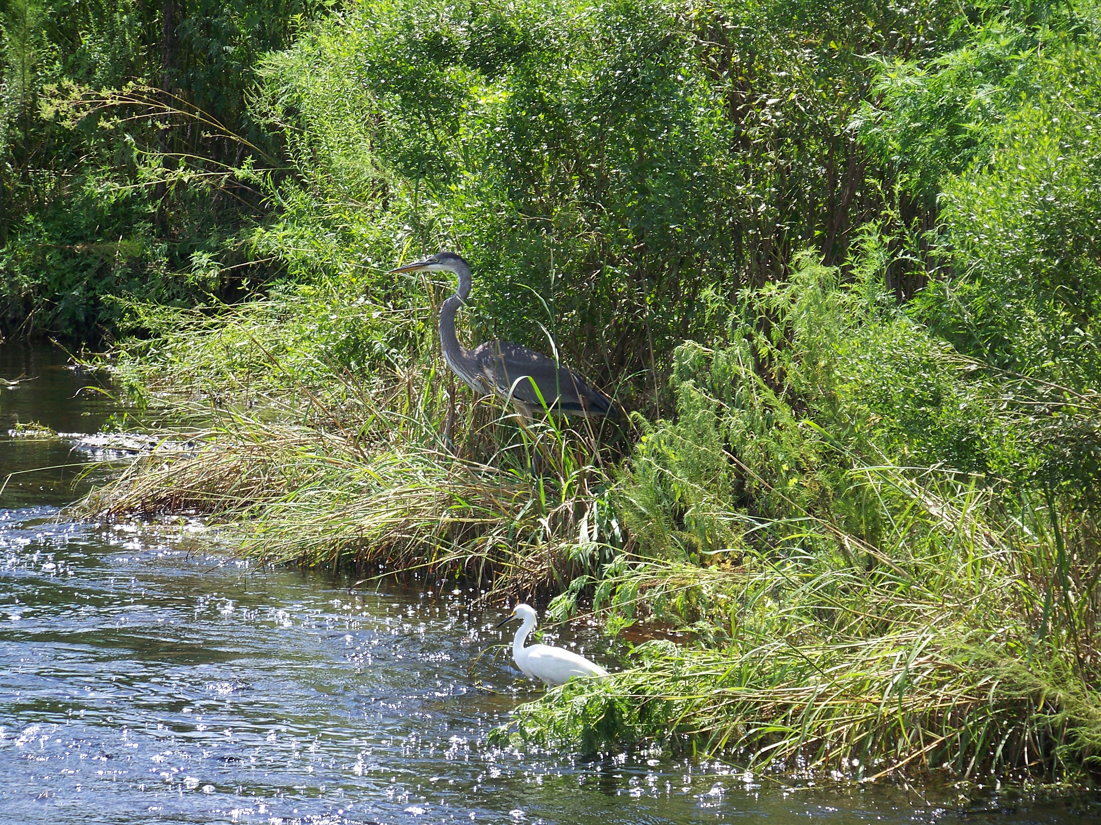
Perception is an active process based on context and predictions
We see what we want to see!

Slide 8
Perception is an active process: From memory predictions to saccades
We only see with high spatial resolution 1.5~5 deg of the full visual field, which is called foveal vision.
Saccades can be considered one crucial motor aspect of active perception that has evolved to support survival.
Most of prediction is done on the blurred background
We are modeling perception as a continuous loop, in which a new saccade marks the onset of a new sampling episode, informed by previous information accumulated in association memory.

Slide 9
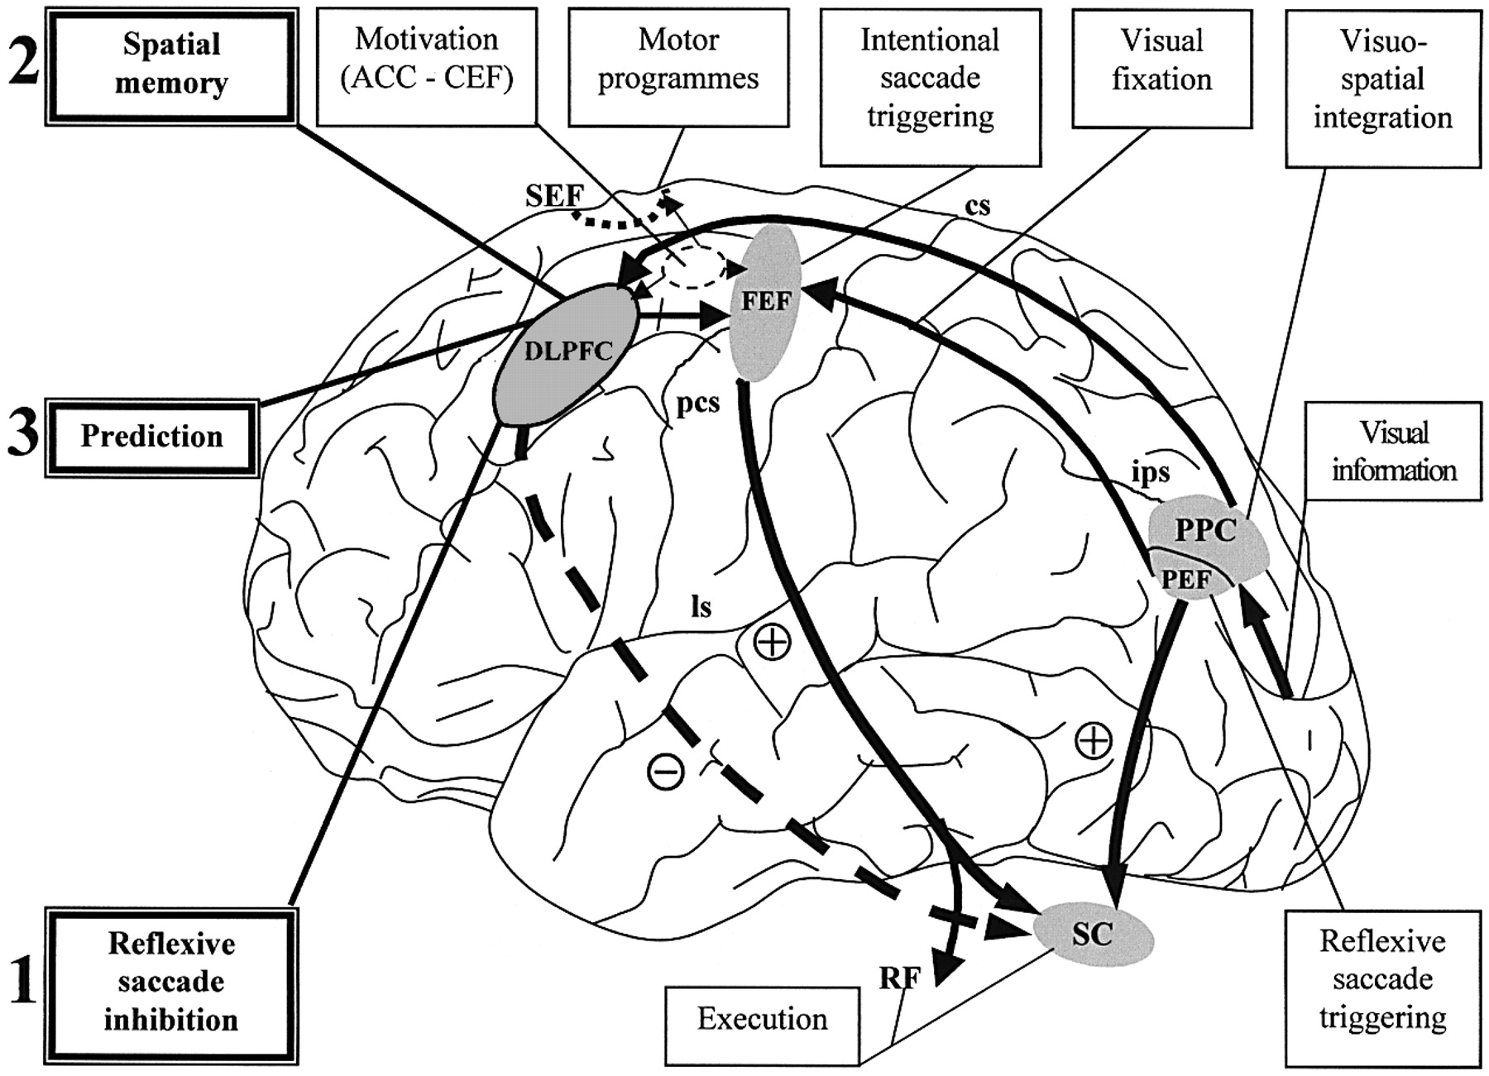
Human Visual System
Rather than processing an entire scene at once, the HVS fixates on small regions, forms representation of these regions, and combines them into an overall view
Dorsal Path
WHERE
Ventral Path
WHAT

Slide 10
Human Visual System
Ventral Pathway
Object Identification
Works with fine visual details over small areas (foveal region)
Uses long term memory to store representations of objects
Dorsal Pathway
Object Location
Spatial perception and motion over large areas
Requires working memory to place objects in scenes
Hypothesis: By combining a fixation and saccade system (dorsal pathway) with an object recognition system such as a neural network (ventral pathway), we can create an artificial active vision system.
Method: Model perception as a continuous loop to extract events in the real world, in which a new saccade marks the onset of a new sampling episode, informed by previous information accumulated in association memory.

Slide 11
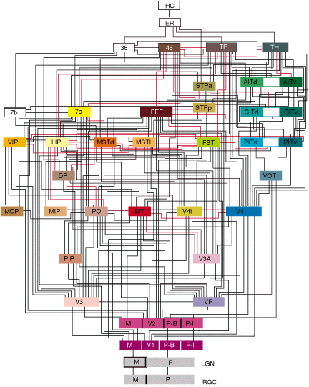
Neural Anatomy of the Visual System
Helmholtz’ stated that cortical function evolved to explain sensory inputs.
As such we seek to understand the role of processing and stored experience in a machine learning framework for the decoding of sensory input.
¹ Felleman DJ, Van Essen DC. Distributed hierarchical processing in the primate cerebral cortex. Cereb Cortex. 1991 Jan-Feb;1(1):1-47.

Slide 12
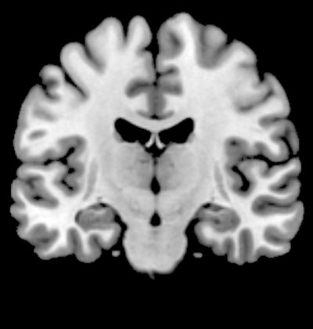
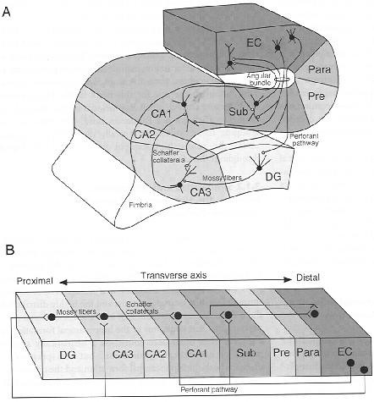
Hippocampal-Neocortical Loop: Episodic Memory Encoding & Consolidation
Memories are bound in HC
Export to temporal neocortex
Long-term storage (passive)

Slide 13
Human Memory: Taxonomy & Architecture
Memory
Declarative
Non-Declarative
Working
Semantic
Procedural
Non-Associative
Episodic
Priming
Conditioning
Memory is an extremely important aspect of cognition.
flashbulb
autobio
prospective
(Squire, 2004)

Slide 14
Cognitive Memory - Theory
Computer Science Perspective
The digital computer has been a tremendous force to shape a theory of memory. But the role of memory in a Turing Machine architecture results from formal systems assumptions and should not be portrayed as the ONLY possible role for memory (storage of code/data).
Cognitive Memory Perspective
Has been mostly a top down approach about hypothesis of how the brain works, informed by neuroscience and behavior experiments, but ultimately implemented in Von Neumann simulators.
NeuroTuring Perspective
Recently, a differentiable implementation of the Turing machine was proposed by Graves, which extends this paradigm (external memory) to neural networks, but still fails short of Super-Turing machines.

Slide 15
Cognitive Memory - Theory
Humans extract events from the continuous flow of time to build their experience with world events important for survival, and to simplify information processing when a similar situation appears in the future.
Cognitive memory fades and may be transformed
Memory of objects shapes the response of the organism through top-down attention (we see what we want to see).
Episodic memory is an enabler and consequence of sensory processing, but it has not been the traditional way to study memory function.
Properties of objects (features and affordances) allow reasoning. Many consider memory the most important resource in brain processing.

Slide 16
Cognitive Memory Design Methodology
We seek to understand the role of memory in a machine learning framework for the decoding of sensory information.
Along these lines we assign to memory the important role of storing abstract, computed online and onsite, representations of sensory dynamic scenes, which we call the causes.
To be useful for the subject’s survival, causes need to be associated and consolidated with other concurrent brain activity, which is the function of the hippocampus at the top.
From a machine learning perspective, causes help create the priors to later disambiguate the world (background/ figure segregation) and assign probabilities to events.

Slide 17
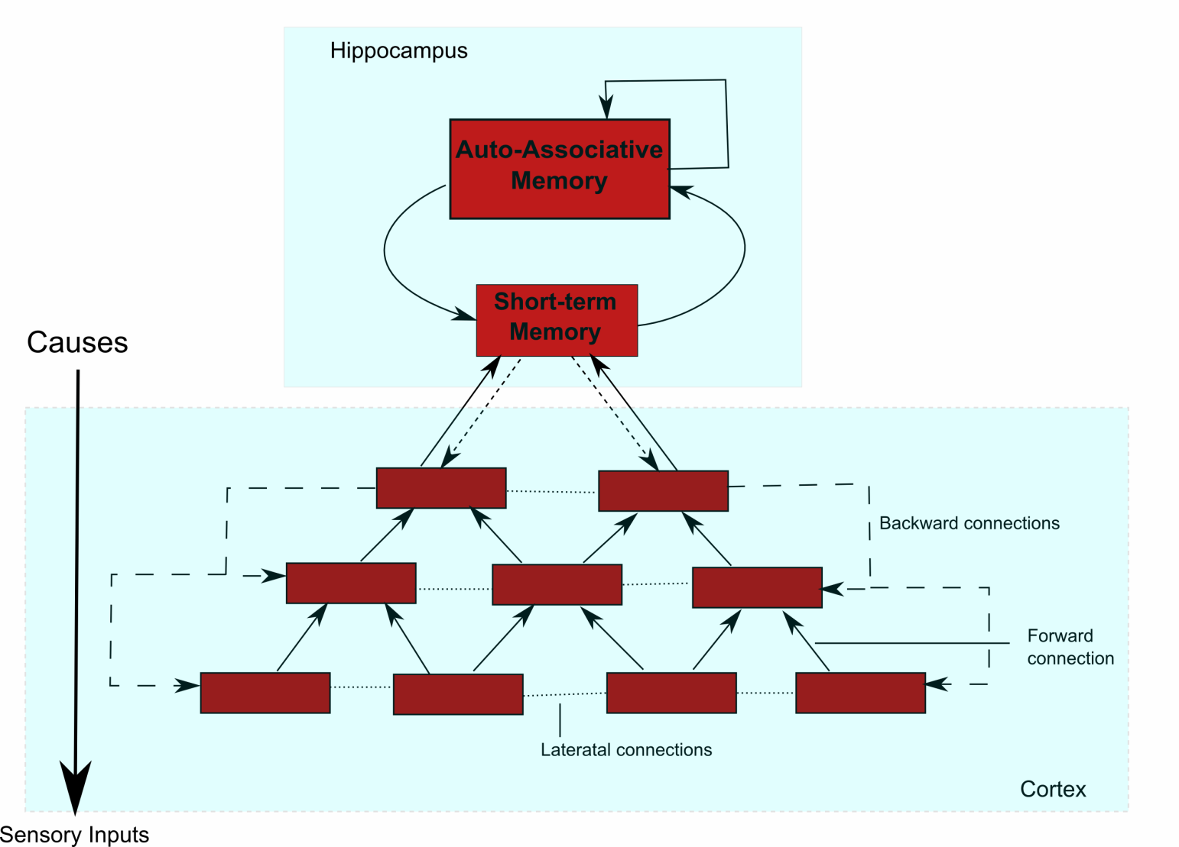
Cognitive Perception Architecture Generative Model for Learning and Memory
The brain is modeled as an inference machine where the hidden causes try to predict the sensory inputs.

Slide 18
Generative Model for Learning and Memory
An object recognition model requires:
Feature Extraction from movies: We propose an algorithm that can perform sparse coding of low-level features while considering the dynamics and objects present in the observations.
Invariant Representation: Extend the previous sparse coding model with locally invariant representations to obtain abstract information.
Building Feature Hierarchies: feature hierarchies provide more abstract representation for objects at higher levels and are learned by stacking these dynamic models with sparse coding through a greedy layer-wise procedure.
Store causes in content addressable memories: Use past experience as a way to guide perception of new scenes.
Training for consolidation and recall: Fine tune these features to build a better recognition system. We propose to use the backward predictions, along with the empirical priors, to achieve this.

Slide 19
How do Technologists Approach Memory?
Very differently from biology:
The Turing Machine metaphor relegates memory to a secondary role (storage of programs and results). Memory is accessed randomly by an address.
Digital memory lasts forever without degradation.
It preserves properties of formal systems.

Slide 20
Kernel CAM
In neural networks we prefer to design content addressable memories (CAMs), which use the input data as an address for the stored information (phone book)
The advantage of CAMs is that memories are naturally organized by similarity (using the metric of the space).
Human declarative memory seems to be well modeled by the CAM Paradigm (stimulus triggers a response). Large body of work exists in training CAMs with Hebbian learning.
Their major problem is the strict constraint between the input pattern size and the memory storage for perfect recall (only N orthogonal directions in N dimensional space).
We developed and tested a functional space methodology that lifts these assumptions (storage is independent of size of input patterns), which we called the Kernel CAM.

Slide 21
Kernel CAM
To improve on conventional CAMs, data is transformed from input space into a feature space of much higher dimension.
We will use kernel methods because mathematics are well developed but the key is to represent input data by local functions (as neural activity?).
represents the mapping from the input space X into the feature Hilbert space F, .
The kernel function is
The Gaussian kernel is selected as the kernel function because it produces, in principle, an infinitely dimensional space.

Slide 22
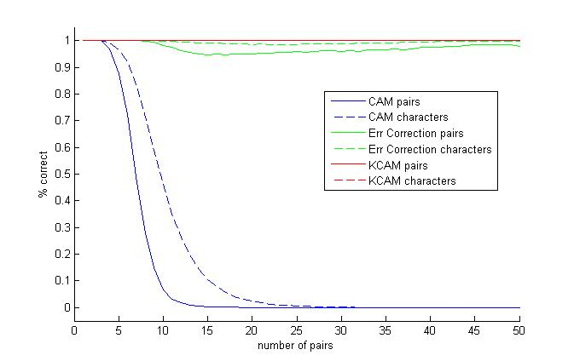
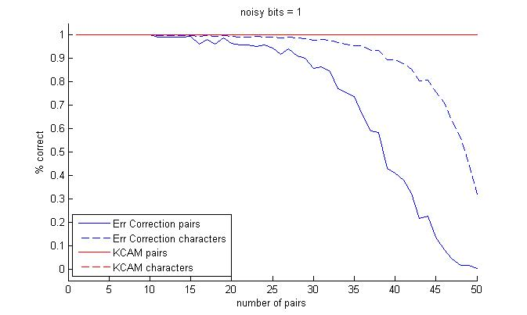
Kernel CAM
To retrieve the desired pattern from its corresponding input vector in the RKHS, we compute:
Compared to CAMs, where only the connection matrix W needs to be stored; in Kernel CAM, all the association pairs need to be stored, which requires more storage space than CAM
Notes:
Dr. Principe, the desired output d in the equation above can easily be replaced by the input x to obtain a reconstructed image

Slide 23
Memory in Stochastic Processes
A stochastic process has the Markov property if the conditional probability distribution of future states of the process (conditional on both past and present states) depends only upon the present state, not on the sequence of events that preceded it.
P(X_{n}=x_{n}|X_{n-1}=x_{n-1},…,X₀=x₀) = P(X_{n}=x_{n}|X_{n-1}=x_{n-1})
A Markov Process has memory of one sample (or interval).
If one wants more, need to create a Markov Chain and specify the length of the chain.

Slide 24
Memory in Stochastic Processes
In signal processing we define functionals in the real line that are absolutely summable in some domain (myopic). Myopic means fading memory for both causal and non causal components.
Sandberg 1997 proved an important theorem that states the necessary and sufficient condition under which multidimensional input–output mappings with vector-valued inputs drawn from a myopic spaces can be uniformly approximated arbitrarily well using a structure consisting of a linear preprocessing stage followed by a memoryless nonlinear network.
The gamma (and the Laguerre) functions are such a preprocessing stage

Slide 25
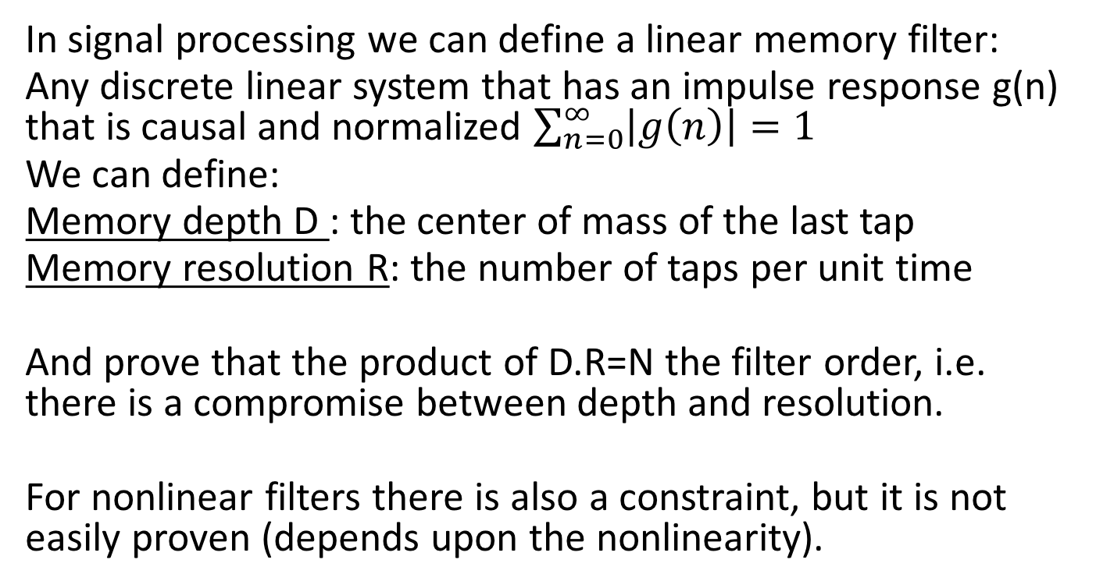
Linear Memory Filter

Slide 26
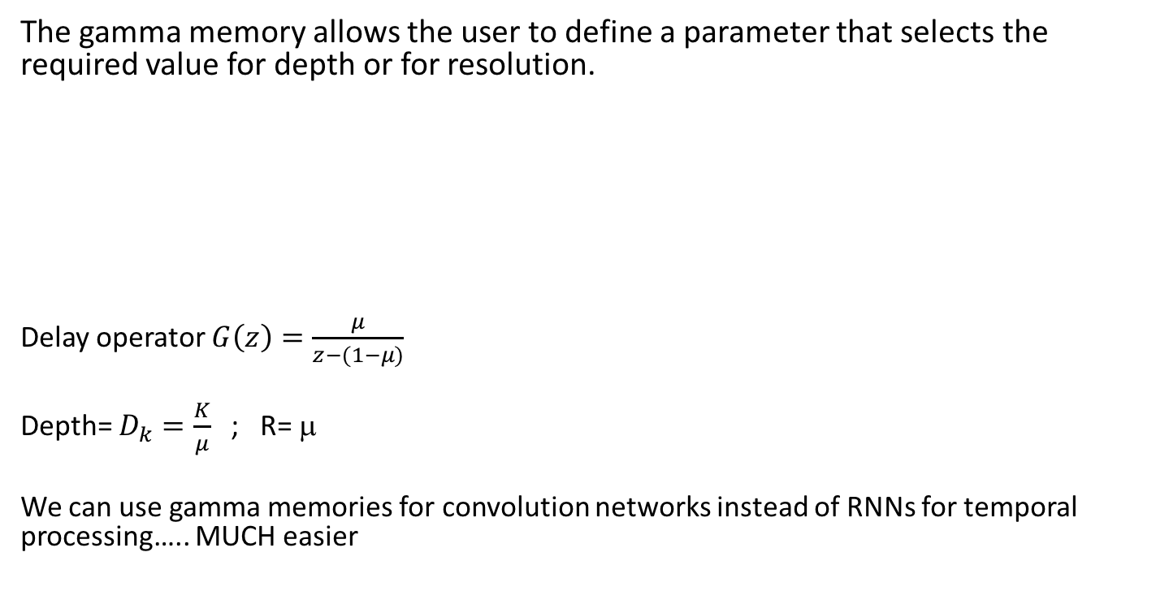
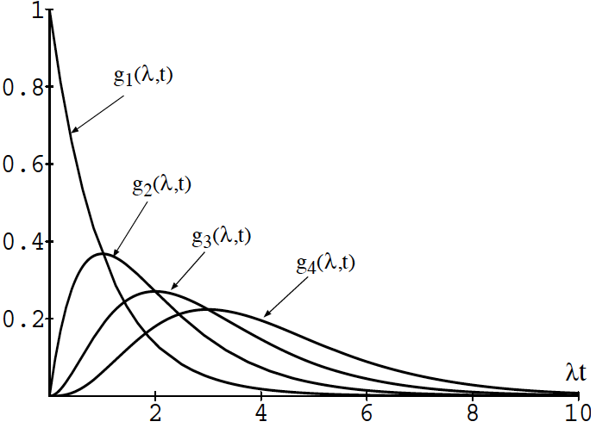
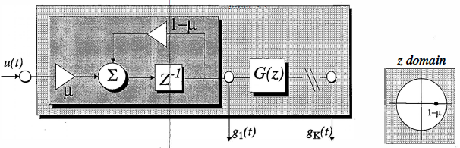
The Gamma Memory

Slide 27
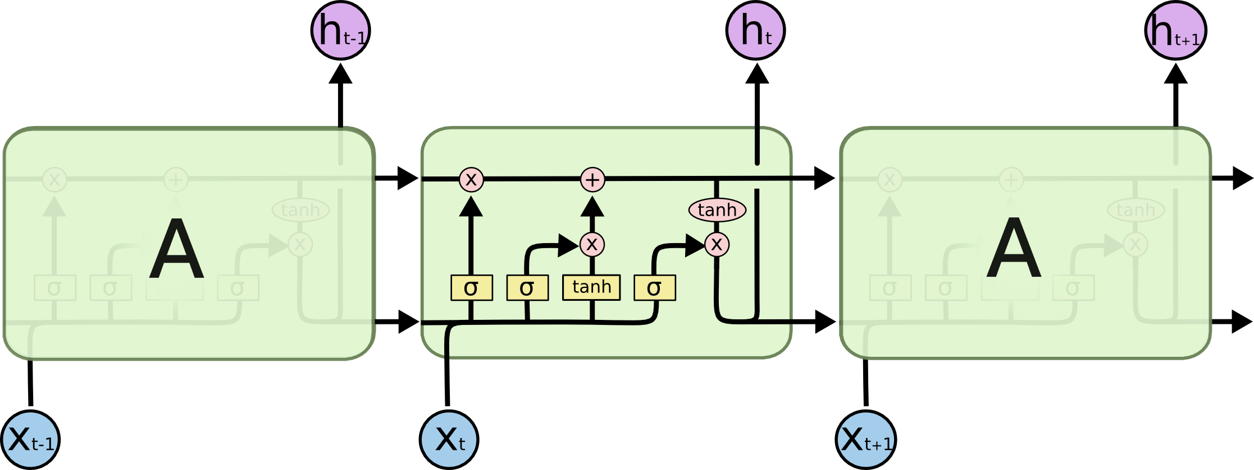
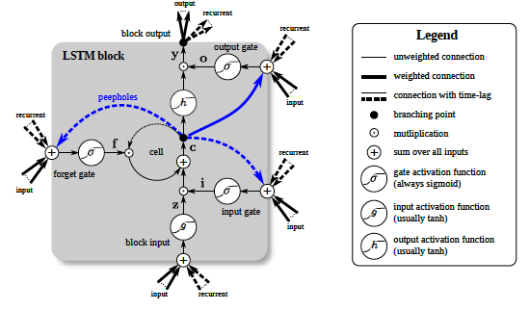
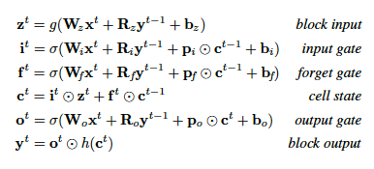
Long Short Term Memory (LSTM)
Currently the standard memory block in deep learning is the LSTM introduced by Hochreiter and Schmidhuber. Its appeal is exactly to learn the best compromise memory / resolution for the application. But it requires lots of data and it is not easy to train.

Slide 28
How do Technologists Approach Perception?
Also very differently from biology:
Computer vision and machine learning formulate perception as pattern recognition using statistical learning!
This is a passive process where the system reacts to data, i.e. strictly bottom up processing!
The most developed methodology is supervised learning, which is also very constraining – because it requires an artificial target!
So designers are always in the learning loop and don’t allow models to learn from experience with new data…. Because of catastrophic forgetting….

Slide 29
Feature Selection
What are good features for sensory processing?
Note: this is crucial “ you cannot make good omelets with rotten eggs”
We really don’t know! but keep on using almost exclusively the sensory space (audio, video) to find them (SIFT, HOG).
Does this approach make sense? Probably not….. Because of the complexity and variability of the sensed signals (differences in illumination, shape, noise, context), while we only need invariants in MODEL space!
Are there alternatives? Of course there are, deep learning is one of them, but it is not the only one. We organisms are another one….

Slide 30
Supervised Learning Machine Architecture
A learning machine is composed of 3 different parts
MAPPER
COST
LEARNING Alg
Data d
Data x
Adaptive
System
Output
+
e=d-y
y
Cost
Function
Information
Learning
Algorithm

Slide 31
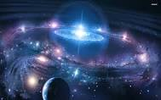

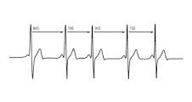
Space-Time Dependencies
The world and us are high dimensional, hugely complex dynamical systems, i.e. movies in high dimensions
Cosmos
Seasons, Circadian cycles
Heart sinus rhythm

Slide 32
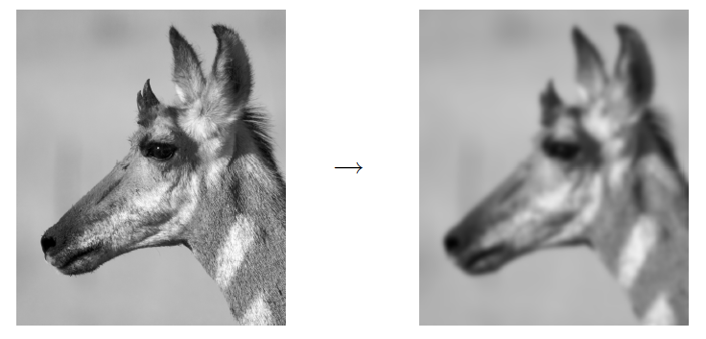

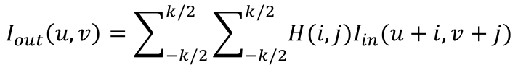
Static Topology
If we are only interested in one frame of the movie – image processing– the goal is to characterize the arrangement of the pixels in the frame.
Key idea is to characterize spatial patterns in neighborhoods
Filtering or discrimination between patterns in frames
H
Cross correlation / convolution

Slide 33
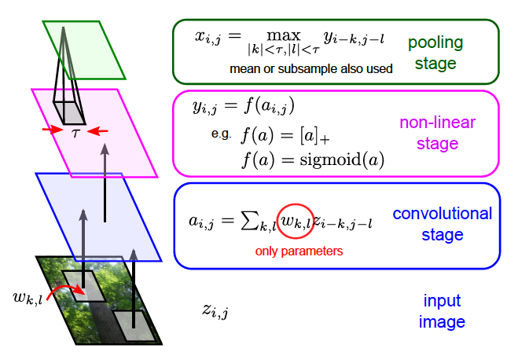
Static Topology- Convolution nets
An example of discrimination is the convolution network that combines multiple filters nonlinearily with sparseness

Slide 34
Static Topology- Convolution nets

Slide 35
Static Topology- Convolution nets

Slide 36
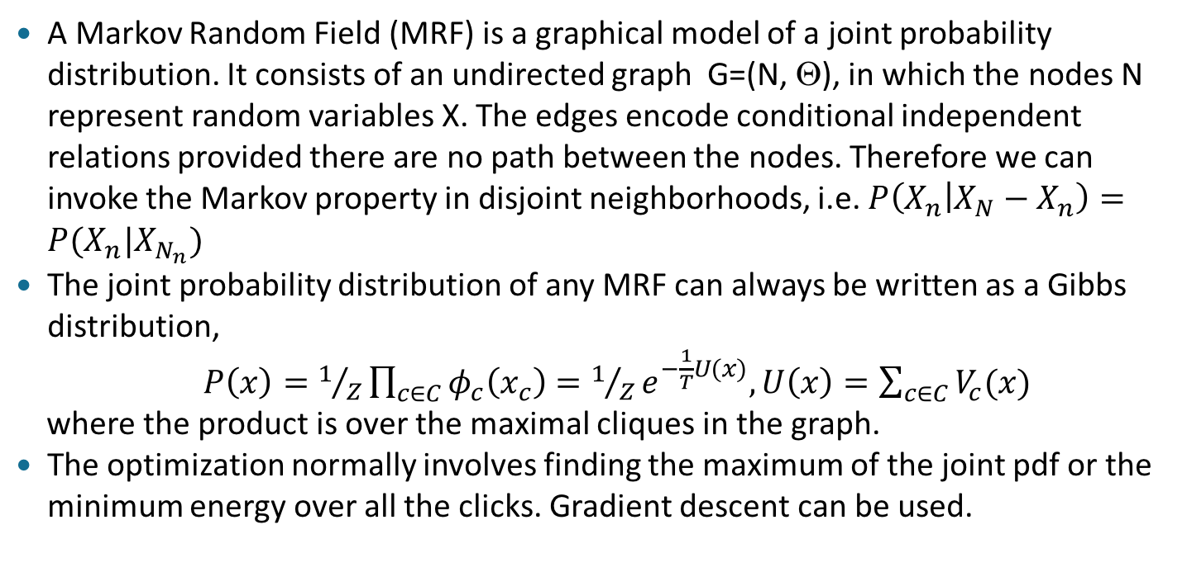
Static Topology- Markov Random Fields

Slide 37
Feedforward Topology
Assume we are interested in time evolution of a pattern
Normally we store several frames of the world and combine them appropriately in neighborhoods by a finite impulse response (FIR) filter (1 pixel)
No context/memory: static mapping.
Rely on a priori knowledge of desired topology.
h(1)
Σ
h(L)
Finite impulse Response filter

Slide 38
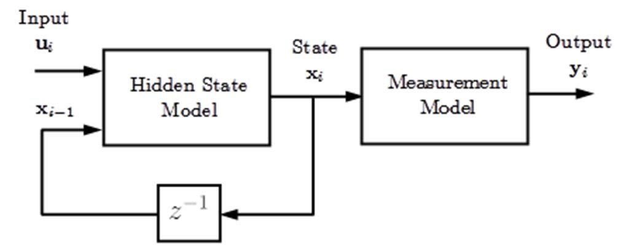
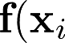
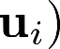
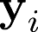
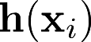

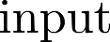

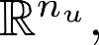


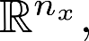



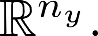
Most General: State-Space Model
LEARNING MACHINE
Current
sample
Memory is inside the model unlike FIR

Slide 39
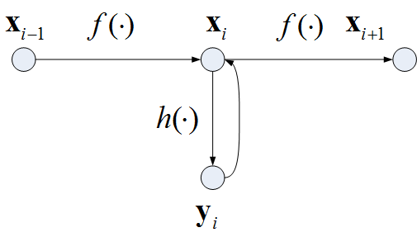

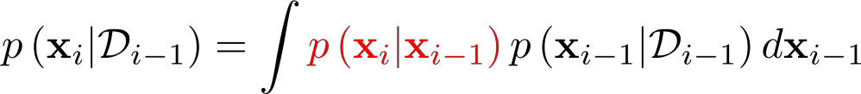
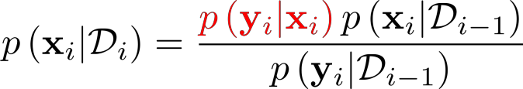
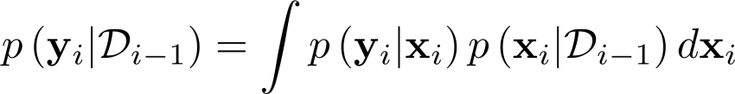
The Bayesian Filter

Slide 40
Recurrent Neural Networks
h_{t}=σ_{h}(W_{h}x_{t}+U_{h}h_{t—1}+b_{h})
y_{t}=σ_{y}(W_{y}h_{t}+b_{y})
x_{t}: input vector
h_{t}: hidden layer vector
y_{t}: output vector
W,U, b: parameter matrices
σ_{h},σ_{y}: nonlinearities
Wikipedia

Slide 41
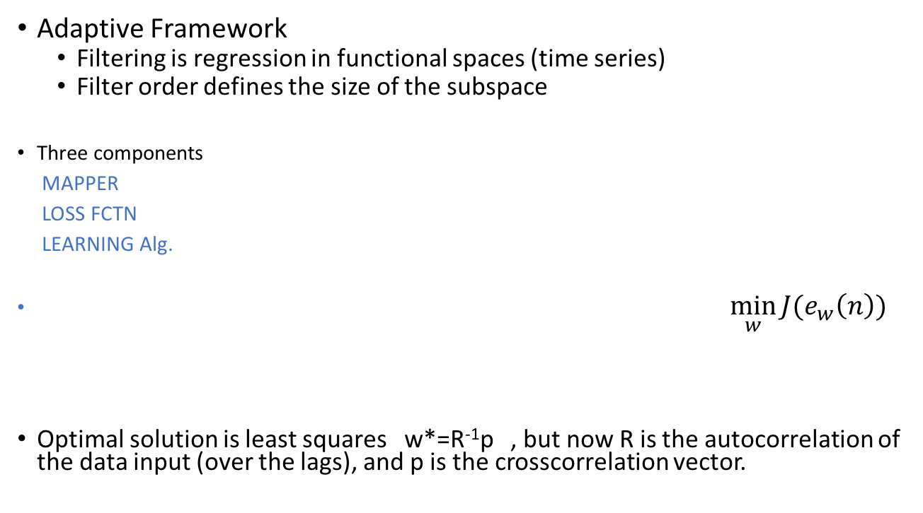
Model Based Machine Learning Fundamentals
Data d(n)
Data u(n)
Adaptive
System
y(n)
Error e(n)=d(n)-y(n)
Output
Cost
J=E[e²(n)]

Slide 42
On-Line Learning for Linear Models
Easiest technique is to search the performance surface J using gradient descent learning (batch).
Gradient descent learning has well known compromises:
Stepsize η must be smaller than 1/λmax (of R) for convergence
Speed of adaptation is controlled by λmin
So eigenvalue spread of signal autocorrelation matrix controls speed of adaptation
The misadjustment (penalty w.r.t. optimum error) is proportional to stepsize, so fundamental compromise between adapting fast, and small misadjustment.
Use ADAM in practice that uses a clever adaptive stepsize.

Slide 43
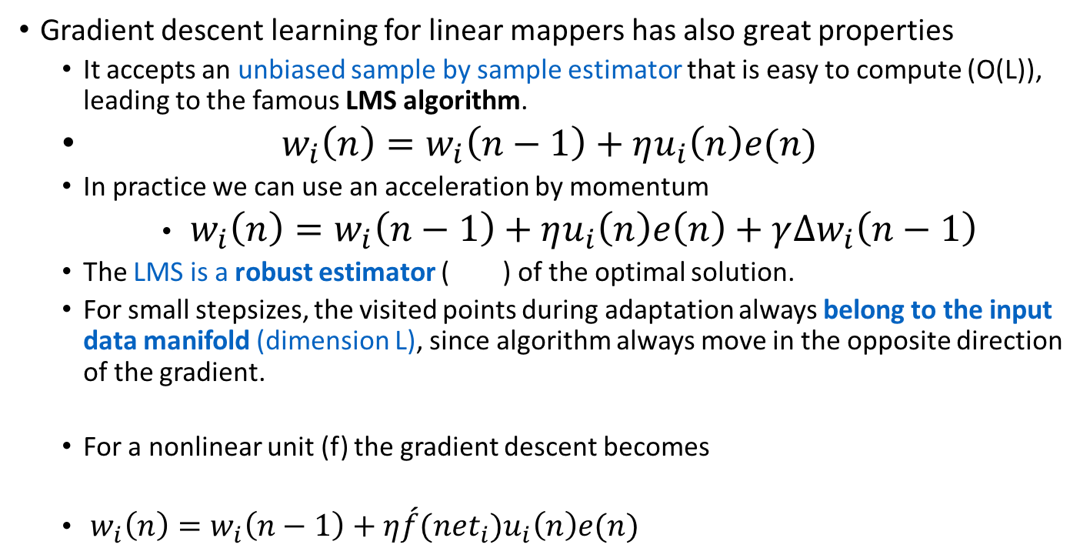
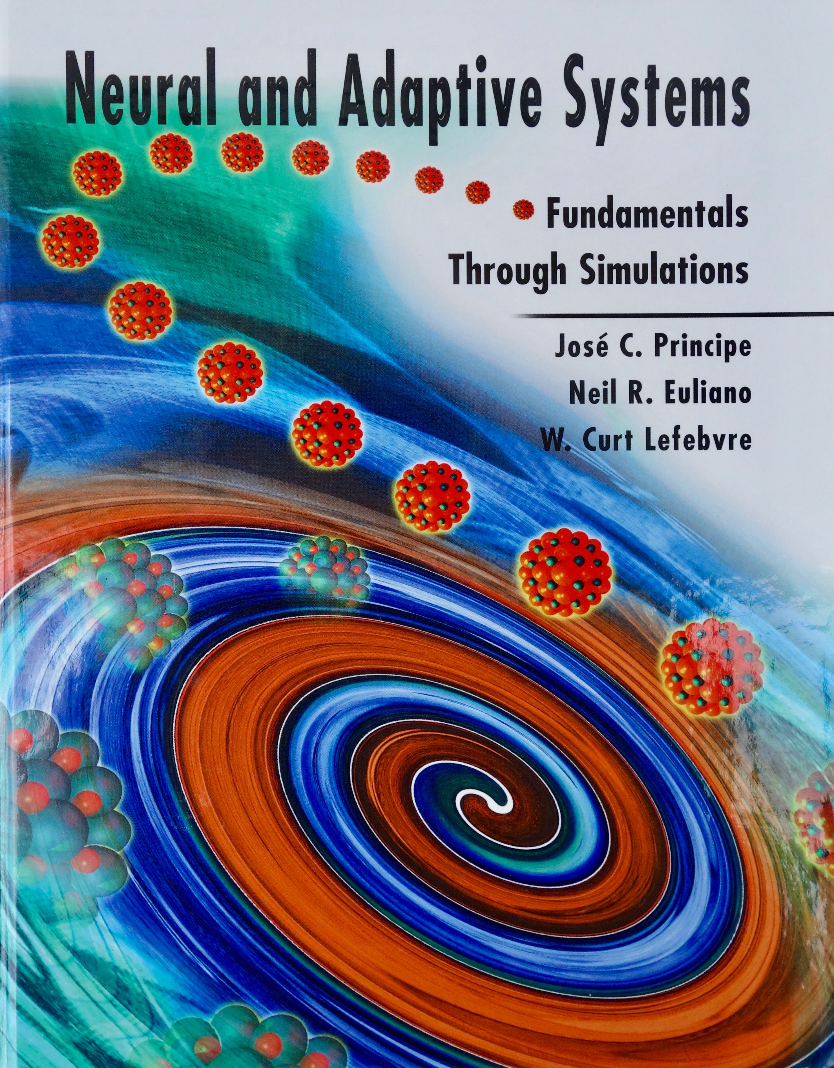
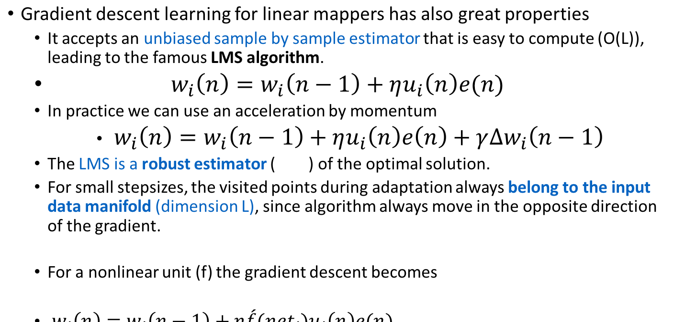
On-Line Learning for Linear/Nonlinear Filters
$$w_{i}(n)=w_{i}(n−1)+η\acute{f}\left({net}_{i}\right)u_{i}\left(n\right)e(n)$$

Slide 44
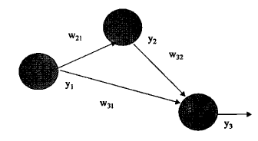
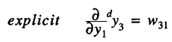
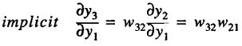
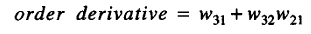
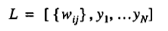
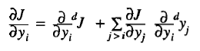
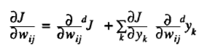
On-Line Learning Using Order Derivatives (Backpropagation)
There are two contributions to the order derivatives : the explicit or direct dependence (super script d) and the implicit dependence through the network.
Create the dependence list
Compute the sensitivity of cost function J with respect to state variables
Compute the sensitivity of the cost w.r.t. to weights
w₂₁
y₂
w₃₂
y₃
y₁
w₃₁

Slide 45
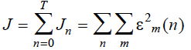
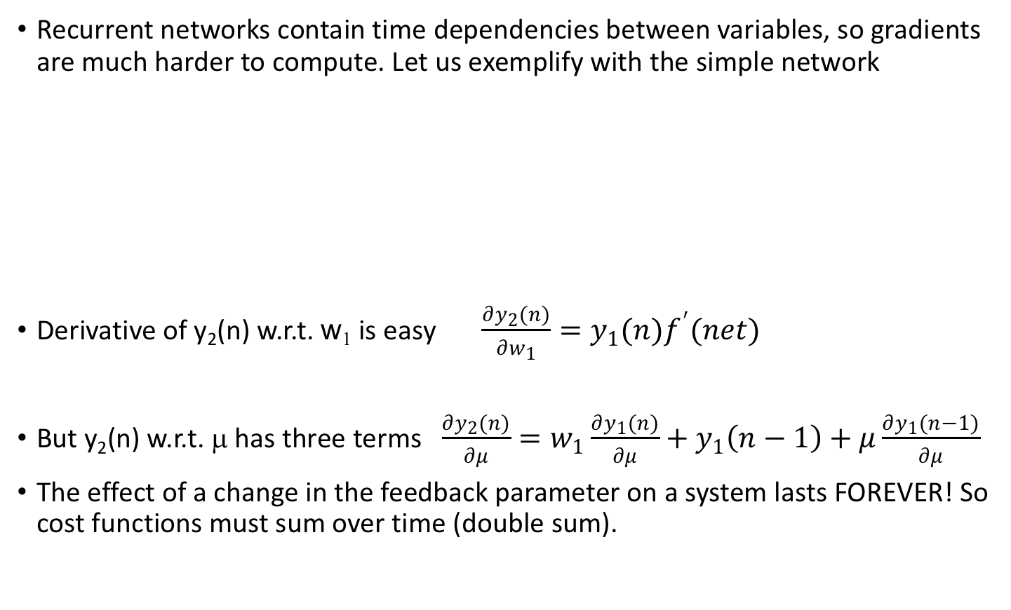

On-Line Learning for Recurrent Linear Filters
Recurrent networks contain time dependencies between variables, so gradients are much harder to compute. Let us exemplify with the simple network
Derivative of y₂(n) w.r.t. w₁ is easy $\frac{∂y_{2}(n)}{∂w_{1}}=y_{1}(n)f^{′}(net)$
But y₂(n) w.r.t. μ has three terms $\frac{∂y_{2}(n)}{∂μ}=w_{1}\frac{∂y_{1}(n)}{∂μ}+y_{1}\left(n−1\right)+μ\frac{∂y_{1}(n−1)}{∂μ}$
The effect of a change in the feedback parameter on a system lasts FOREVER! So cost functions must sum over time (double sum).
$$\left.y_{2}\left(n\right)=w_{1}y_{1}\left(n\right)+μy_{1}\left(n−1\right)+x(n\right)$$

Slide 46






On-Line Learning for Recurrent Linear Filters
The trick is to unfold the network over time to get rid of the recurrency, which can be only done exactly over a finite interval of time [0,T].
For this network this yields
Backpropagation Through Time (BPTT): Notice that the state gradient is noncausal, i.e. it depends future values. This is the reason, in BPTT we invert the error sequence to be able to do the computation using memory (up to some finite time).

Slide 47
Basic idea of on-line Kernel Filtering (Regression)
Transform data into a high dimensional feature space
Construct a linear model in the feature space F
Adapt iteratively parameters with gradient information
Compute the output using representer theorem
Universal approximation theorem
For the Gaussian kernel and a sufficient large m_{i}, f_{i}(u) can approximate any continuous input-output mapping arbitrarily close in the L_{p} norm sense.

Slide 48
Kernel Least-Mean-Square (KLMS)
What people don’t realize is that gradient descent can be easily generalized to reproducing kernel Hilbert spaces (RKHS), creating a universal functional approximator (for some kernels such as the Gaussian)
This simple algorithm is still linear in the parameters, i.e. does not suffer from local minima.
Moreover, it does not need explicit regularization because the norm of the weights is bound.
This leads to a class of simple algorithms we call CULMs (Convex Universal Learning Machines) that can serve well many applications that do not require complex internal representations.

Slide 49
What is Information Theoretic Learning?
ITL is a methodology to adapt linear or nonlinear systems using criteria based on the information descriptors of entropy and divergence.
Center piece is a non-parametric estimator for entropy that:
Does not require an explicit estimation of pdf
Uses the Parzen window method which is known to be consistent and efficient
Estimator is smooth
Readily integrated in conventional gradient descent learning
Provides a link to Kernel learning and SVMs.
Allows an extension to random processes

Slide 50
ITL is a different way of thinking about data quantification
Moment expansions, in particular Second Order moments are still today the workhorse of statistics. We automatically translate deep concepts (e.g. similarity, Hebb’s postulate of learning ) in 2nd order statistical equivalents.
ITL replaces 2nd order moments with a geometric statistical interpretation of data in probability spaces.
Variance by Entropy
Correlation by Correntopy
Mean square error (MSE) by Minimum error entropy (MEE)
Distances in data space by distances in probability spaces

Slide 51
Information Theoretic Learning Entropy
Entropy quantifies the degree of uncertainty in a r.v. Claude Shannon defined entropy as
Not all random variables (r.v.) are equally random!
1
0.4
(x)
0.5
(x)
f
x
f
x
0.2
0
0
-5
0
5
-5
0
5
x

Slide 52
Information Theoretic Learning Renyi’s Entropy
Norm of the pdf:
Renyi’s entropy equals Shannon’s as

Slide 53
Information Theoretic Learning Parzen windowing
Given only samples drawn from a distribution:
Convergence:
1
1
N=10
N = 1000
(x)
0.5
(x)
0.5
f
x
f
x
Kernel function
0
0
-5
0
5
-5
0
5
x
x
0.4
N=10
0.4
N = 1000
(x)
(x)
f
x
0.2
f
x
0.2
0
0
-5
0
5
-5
0
5
x
x

Slide 54
Information Theoretic Learning Renyi’s Quadratic Entropy
Order-2 entropy & Gaussian kernels:
Pairwise interactions
between samples
O(N²)
Information potential, V₂(X)
provides a potential field over the space of the samples
parameterized by the kernel size σ
Principe, Fisher, Xu, Unsupervised Adaptive Filtering, (S. Haykin), Wiley, 2000.

Slide 55
Information Theoretic Learning Information Force
In adaptation, samples become information particles that interact through information forces.
Information potential:
Information force:
x_{i}
x_{j}
Principe, Fisher, Xu, Unsupervised Adaptive Filtering, (S. Haykin), Wiley, 2000.
Erdogmus, Principe, Hild, Natural Computing, 2002.

Slide 56
Training Linear Model sample by sample Stochastic information gradient (SIG)
Batch gradient for any α and any kernel:
Stochastic approximation (SIG) with M samples:
For α = 2 and Gaussian kernel
For M=1, the SIG becomes LMS equivalent
Erdogmus, Principe, Hild, IEEE Signal Processing Letters, 2003.

Slide 57

Information Theoretic Learning Backpropagation of Information Forces
Desired
Input
Adaptive
System
IT
Criterion
Output
Information
Forces
Adjoint
Network
Weight
Updates
Information forces become the injected error to the dual or adjoint network that determines the weight updates for adaptation.

Slide 58
Information Theoretic Learning Quadratic divergence measures
Kulback-Liebler
Divergence:
Renyi’s Divergence:
Euclidean Distance:
Cauchy- Schwartz
Distance :
Mutual Information is a special case (divergence between the joint and the product of marginals)

Slide 59


Training MLPs sample by sample
An MLP can be trained layer by layer, without backpropagating the errors by maximizing the mutual information (QMI CS) between the output of each layer and the desired response.
This is similar to Linsker’s InfoMax (but nonparametric and with a desired signal). Weights are trained with the delta rule.
Frequency doubler network
tdnn 5-2-1

Slide 60
Correntropy: A new generalized similarity measure
Correlation is one of the most widely used functions in signal processing.
But, correlation only quantifies similarity fully if the random variables are Gaussian distributed.
Can we define a new function that measures similarity but it is not restricted to second order statistics?
Use the ITL framework.

Slide 61


Correntropy: A new generalized similarity measure
Correntropy as a cost function versus MSE.

Slide 62
Correntropy: A new generalized similarity measure
Correntropy induces a metric (CIM) in the sample space defined by
Therefore correntropy can
be used as an alternative
similarity criterion in the
space of samples.
Liu W., Pokharel P., Principe J., “Correntropy: Properties and Applications in Non Gaussian Signal Processing”, accepted in IEEE Trans. Sig. Proc

Slide 63
Correntropy: A new generalized similarity measure
Correntropy criterion implements M estimation of robust statistics. M estimation is a generalized maximum likelihood method.
In adaptation the weighted square problem is defined as
When
this leads to maximizing the correntropy of the error at the origin.

Slide 64




Correntropy: A new generalized similarity measure
Nonlinear regression with outliers (Middleton model)
Polynomial approximator

Slide 65

Information Theoretic Learning (ITL)
This class of algorithms can
be extended to ITL cost
functions and also beyond
Regression (classification,
Clustering, ICA, etc). See
IEEE
SP MAGAZINE, Nov 2006
Or ITL resource
www.cnel.ufl.edu

Slide 66
Generative State Models
Supervised learning models estimate E[p(Y|X)], either in regression or classification.
There is a need to learn in an unsupervised way the input X. The unsupervised methodologies normally characterize the pdf modes such as clustering, and use non parametric methodologies.
In classification the Gaussian Discriminant Analysis (GDA) and the Naïve Bayes are simple examples of models that learn p(X|Y) and p(Y).
The simplest of the generative models is the time series predictor, that uses a delay in time to achieve modeling by minimizing MSE. In networks with internal states, it is also possible to use supervised algorithms to achieve the modeling goal.
The two types that we will discuss here are predictive coding models ( with recurrent state) and the deep learning models such as autoencoders (skip deep belief networks). They both create internal representations spaces that can be used to construct approximations of the input, hence their name.

Slide 67







Sparse Coding
We assume that the data X satisfies
Given training data learn dictionary D and code α.
Need to optimize
subject to
Split the problem in two: optimization of A and D.
Reduced optimization subject to
There are fast methods based on conjugate gradient on dual Lagrangian
Then optimize which is convex.
Brian Booth sparse coding, an overview

Slide 68

Dynamic Generative Models
τ
A
x₀
x_{t}
C
y_{t}

Slide 69

Dynamic Sparse Coding
But our goal is to sparsify the states. So using the ideas of Bayesian sparse coding, we select a Gamma distribution for τ and empirically integrate it from data.

Slide 70

Dynamic Sparse Coding

Slide 71

Dynamic Sparse Coding

Slide 72

Dynamic Sparse Coding

